Slide 1
Use of Predictive Analysis for identification of malicious cyber attach on IoT devices (Internet of Things devices) By Aniruddha Joshi DCS 630 May 30, 2024

Slide 2
Agenda
Introduction
Challenge
Data Preparation and Method
Visualizing results
Recommendation
Risk Mitigation
Next Steps

Slide 3

The IoT Security Challenge
Problem: The rapid growth of IoT devices expands our attack surface.
Impact: Cyberattacks can disrupt operations, compromise data, and damage our reputation.
Our Goal: Proactive threat detection to safeguard our IoT infrastructure.

Slide 4
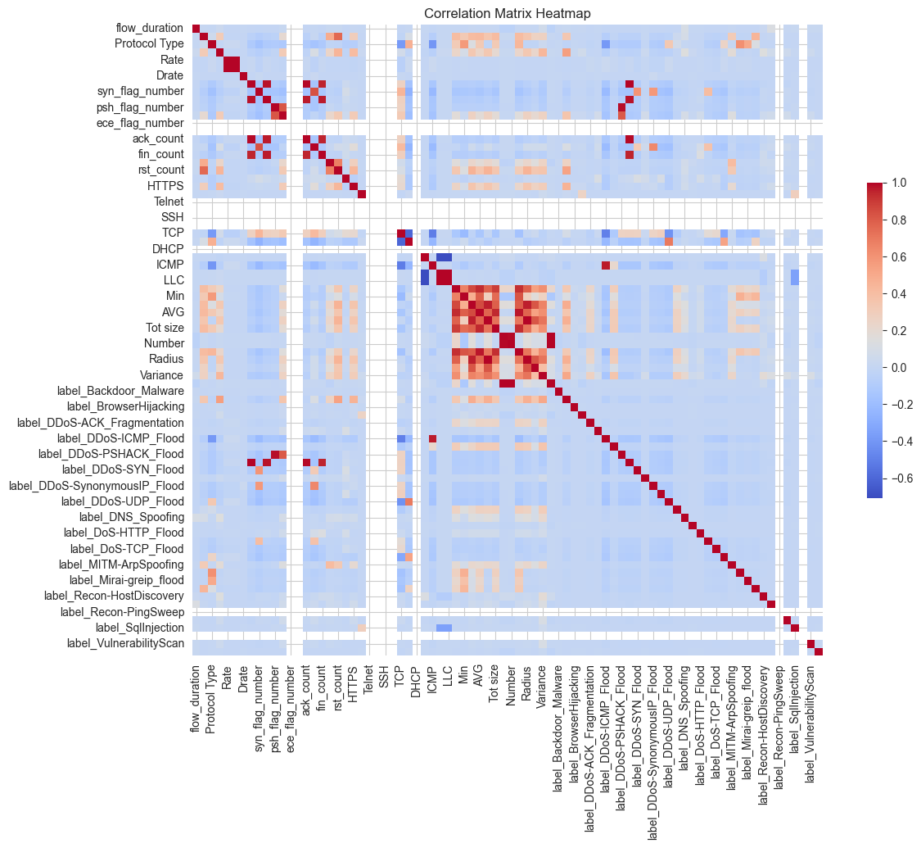
The CICIoT2023 Dataset
Source: Canadian Institute for Cybersecurity (CIC)
Data Richness: Diverse IoT devices, real-world & simulated attacks
Our Focus: 50,000 records for efficient model training

Slide 5
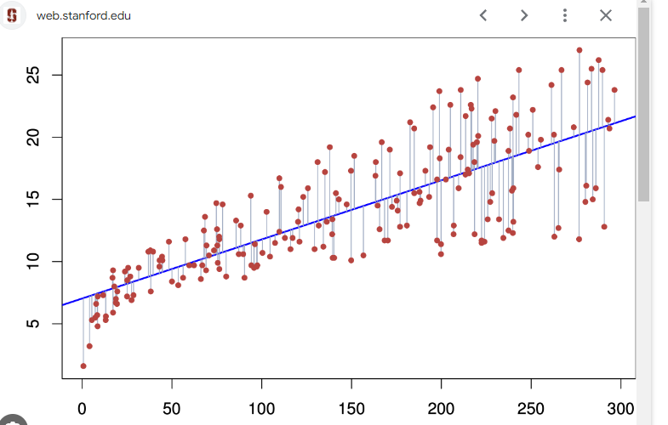
Our Approach: Machine Learning
Why Machine Learning? Adapts to evolving threats, uncovers hidden patterns
Model Selection: Logistic Regression (initial focus)
Explainable, efficient for large datasets
Image source: web.Stanford.edu

Slide 6
Data Preparation
Key Steps:
Cleaning (removing duplicates, outliers)
Feature Engineering (converting categorical data, scaling)
Train-Test Split (80/20)
Goal: Prepare high-quality data for accurate model training

Slide 7
Model Training & Evaluation
Metrics:
Accuracy: 80.17% (overall correctness)
Recall: 58.55% (ability to detect attacks)
Precision: 48.31% (avoiding false alarms)
Interpretation: Decent overall accuracy, room for improvement

Slide 8
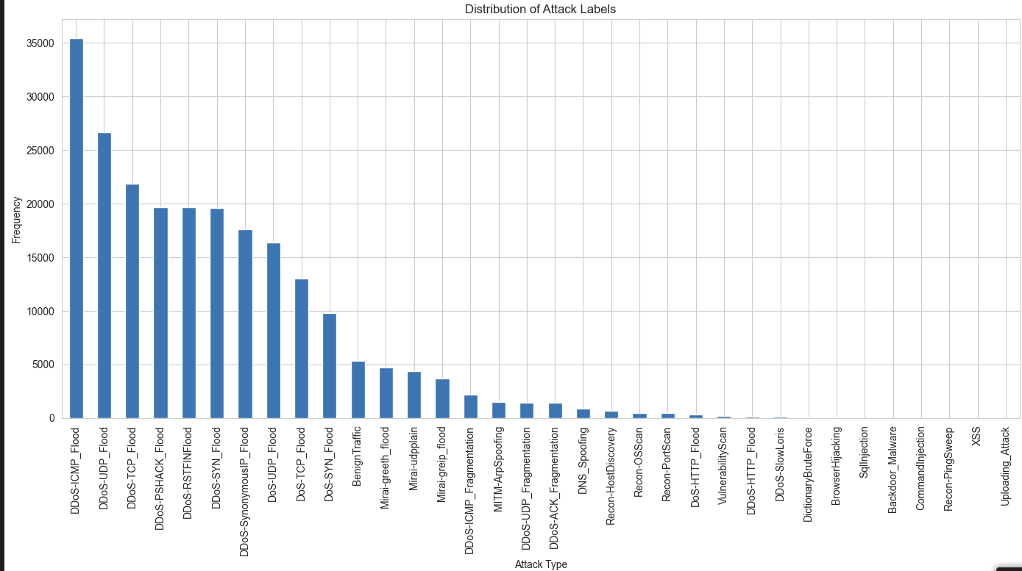
Visualizations

Slide 9

Recommendations: Model Refinement
Hyperparameter Tuning: Optimize model settings for better performance
Alternative Algorithms: Explore Random Forest, K-Means Clustering
Feature Engineering: Craft new features for deeper insights
Next Steps:
Goal: Test the model on live IoT traffic
Benefits: Immediate alerts, proactive threat mitigation
Image source: senetco.com

Slide 10
Risk Mitigation
Model Bias: Ensure the model is fair and unbiased
False Positives: Fine-tune to minimize unnecessary alerts
Ongoing Monitoring: Continuously update and retrain the model

Slide 11
Business Value
Reduced Downtime: Minimize disruptions caused by cyberattacks
Data Protection: Safeguard sensitive information
Cost Savings: Prevent financial losses due to breaches
Competitive Advantage: Enhance security, build customer trust

Slide 12
Next Steps
Research: Explore additional algorithms, data sources
Development: Refine and optimize the model
Deployment: Implement real-time monitoring and alerting

Slide 13
Call to Action
Proposal: Invest in further development and deployment
Impact: Strengthen our IoT security posture, protect our assets
Open for Discussion: Questions?

Slide 14
Thank you!!

